Slide 1



Emergency Routing
Karthik Mohan
Amarpreet Singh
Nirmit Zinzuwadia
Final Presentation

Slide 2
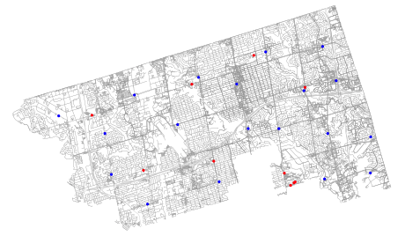
Introduction
Focus: North York, Toronto, Canada
Services considered: Ambulances and Fire Trucks
Target Users: Emergency Responders and Bystanders
Challenges: Runtime and emergency responder data
Live Traffic Data: Bing Traffic API
Hospitals
Fire Stations

Slide 3
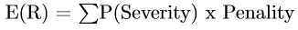
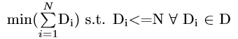
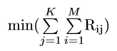
Problem Formulation and Modeling
Objective Equations
Minimize risk of delays Minimize emergency responders dispatched Minimize response travel time | M = total number of emergencies K = total number of emergency responders available N = total number of emergency responder centers D_{i} = number of emergency responders dispatched from location i (i [1, N]) ER_{i} = location of emergency responder i (i [1, K]) E_{i} = location of the emergency i (i [1, M]) R_{ij} = travel time from E_{i} to E_{j}

Slide 4
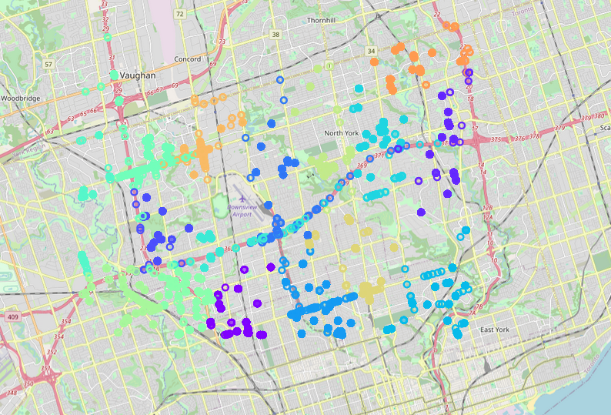
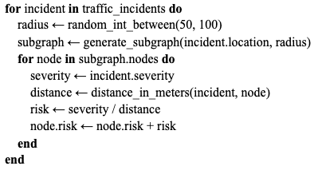
Traffic Incidents Data
Historical Traffic
K-Means
Live Traffic
Node and edge risk scores

Slide 5
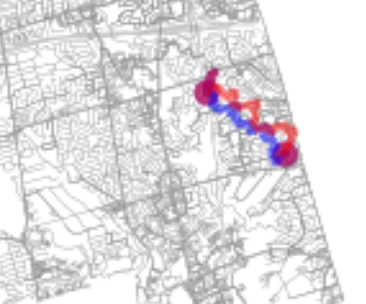
Importance of Weights
Risky nodes have inflated weights
Blue → Path nodes with low risk
Red → Path nodes with high risk

Slide 6
Algorithms Utilized
Deterministic Search -> Graph Search Methods -> Informed Search -> Shortest Path -> A*
Stochastic Search -> Trajectory Method -> Simulated Annealing
Stochastic Search -> Population Based Methods -> Swarm Intelligence -> Practicle Swam Optimization
Search Algorithms
Exact Algorithms
Approximate Algorithms
Graph Search
Stochastic
Informed Search
Trajectory
Population Based
SA
PSO
A*

Slide 7
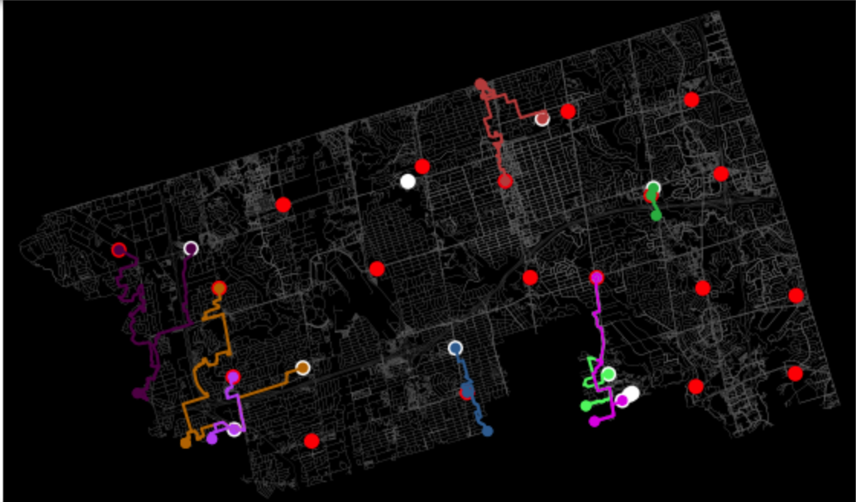
Demo 1: Accidents < EV - A*
Hospital
Fire Station
Other points = accidents

Slide 8
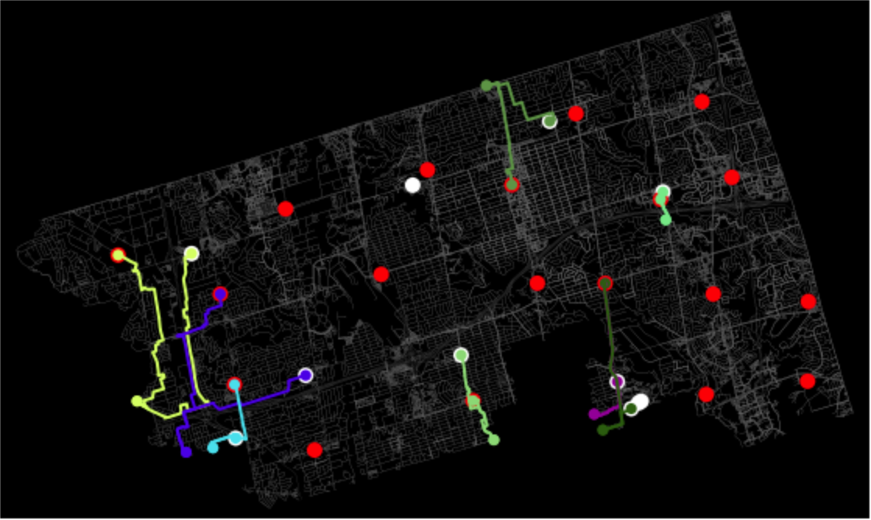
Demo 1: Accidents < EV - PSO
Hospital
Fire Station
Other points = accidents

Slide 9
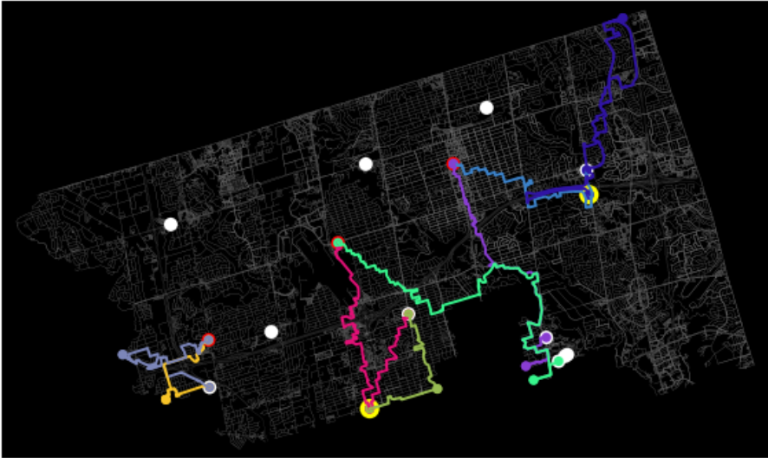
Demo 2: Accidents > EV - A*
Hospital
Fire Station
Reroute from accidents
Other points = accidents

Slide 10
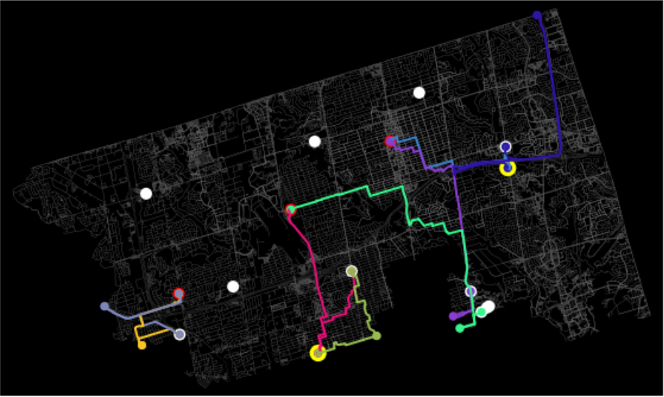
Demo 2: Accidents > EV - PSO
Hospital
Fire Station
Reroute from accidents
Other points = accidents

Slide 11
Which one is better?
 | A* | PSO
Demo 1 | 1 min 37 sec | 3 min 43 sec
Demo 2 | 3 min 24 sec | 7 min 21 sec
CPU runtime for each case
The reason for the longer execution time of PSO is because of the longer routes and less amenities, due to which the algorithm routes the responders available at the farthest places in the city to the emergency locations.

Slide 12
Related Work
Paper | Algorithm(s)
A Discrete Inspired Bat Algorithm for Fire Truck Dispatch in Emergency [1] | Discrete Inspired Bat Algorithm
Performance Analysis of Genetic Algorithms for Route Computation Applied to Emergency Vehicles in Uncertain Traffic [2] | Genetic Algorithms
Dispatching fire trucks under stochastic driving times [3] | Markov Chain and heuristic based on a queueing approximation
An Optimization Model for Real-Time Emergency Vehicle Dispatching and Routing [4] | Dynamic shortest path algorithm
The Emergency Vehicle Routing Problem with Uncertain Demand under Sustainability Environments [5] | Hybrid algorithmic approach: particle swarm optimization algorithm and path relinking strategy

Slide 13
Conclusion
Algorithms explored
A* and PSO
Heuristics used
Live and Historical Traffic Incidents
Next steps
Exploration of larger region than North York
Improving performance by reducing runtime
Evaluate the performance with more non deterministic algorithms

Slide 14
Q & A

Slide 15
References
[1] Trachanatzi, D., Rigakis, M., Marinaki, M., & Marinakis, Y. (2020). A Discrete Inspired Bat Algorithm for Fire Truck Dispatch in Emergency. Natural Risk Management and Engineering: NatRisk Project, 203.
[2] Constantinescu, Vlad & Patrascu, Monica. (2020). PERFORMANCE ANALYSIS OF GENETIC ALGORITHMS FOR ROUTE COMPUTATION APPLIED TO EMERGENCY VEHICLES IN UNCERTAIN TRAFFIC.
[3] Usanov, D., van de Ven, P. M., & van der Mei, R. D. (2020). Dispatching fire trucks under stochastic driving times. Computers & Operations Research, 114, 104829.
[4] A. Haghani, H. Hu, Q. Tian. “An Optimization Model for Real-Time Emergency Vehicle Dispatching and Routing”. In Transportation Research Board. 2013.
[5] Qin, Jin & Ye, Yong & Cheng, Bi-rong & Zhao, Xiaobo & Ni, Linling. (2017). The Emergency Vehicle Routing Problem with Uncertain Demand under Sustainability Environments. Sustainability. 9. 288. 10.3390/su9020288.

